Slide 1
EDI REJECTIONS
CureMD
Practice without boundaries

Slide 2
Table of Contents
Claims Process.
What is EDI in Medical Billing.
Overview of EDI file.
Types of EDI Rejections.
Claims Forms.
What are claim rejections?
Reasons for claim rejections
How to minimize claim rejections?
Key Takeaways

Slide 3

Project analysis slide 3
Claims Process
The claims process is a dense, complex, but no-less crucial component to the healthcare industry
Claim
Origination
Claim Scrubbing
Claim Submission
Claim
Adjudication
Payment Determination
After the charges and payments are entered, claim is generated, which includes the date of service and essential provider information, i.e. provider’s name, location, signature, and National Provider Identifier (NPI).
In some cases, it may include an admission date & information for billing & referring provider
During claim generation, billers scrub claims to ensure all procedure, diagnosis, and modifier codes are present and accurate.
To accomplish this stage medical billers typically run claims through claim
scrubbing software (practice management system) i.e. 10g.
Submit the claim electronically to the insurance company using a practice management system or a clearinghouse.
Attach any necessary supporting documentation, such as medical records or prior authorization forms, if required
The insurance company calculates the amount they will pay for each service based on contracted rates and coverage.
Deductibles, co-payments, and co-insurance amounts are applied.
Adjudication refers the review process
and determination of if & how much a payer will pay the provider, based on the information that
biller provided

Slide 4
Project analysis slide 8
What is EDI in medical billing
Stands for Electronic Data Interchange
In the context of medical billing, EDI refers to the electronic exchange of healthcare-related information and transactions between healthcare providers, insurance companies, and other relevant parties.
EDI in medical billing streamlines this process by allowing healthcare providers to electronically submit claims, receive remittance advice, check patient eligibility and benefits, and perform various other billing-related tasks.

Slide 5
Project analysis slide 8
Overview of EDI file
ANSI (American National Standard Institute)
ANSI (American National Standards Institute) is the main organization supporting the development of technology standards in the United States. ANSI works with industry groups, and it is the U.S. member of the International Organization for Standardization (ISO) and the International Electrotechnical Commission (IEC).
X12 (standard format)
X12 is a message formatting standard used with Electronic Data Interchange (EDI) documents for trading partners to share electronic business documents in an agreed-upon and standard format. It is the most common EDI standard used in the United States.

Slide 6
Types of EDI Files
270 271 837 997 835 | Eligibility Inquiry. Inquiry response. Claim submission. Ins Acknowledgement. Claim payment information.

Slide 7
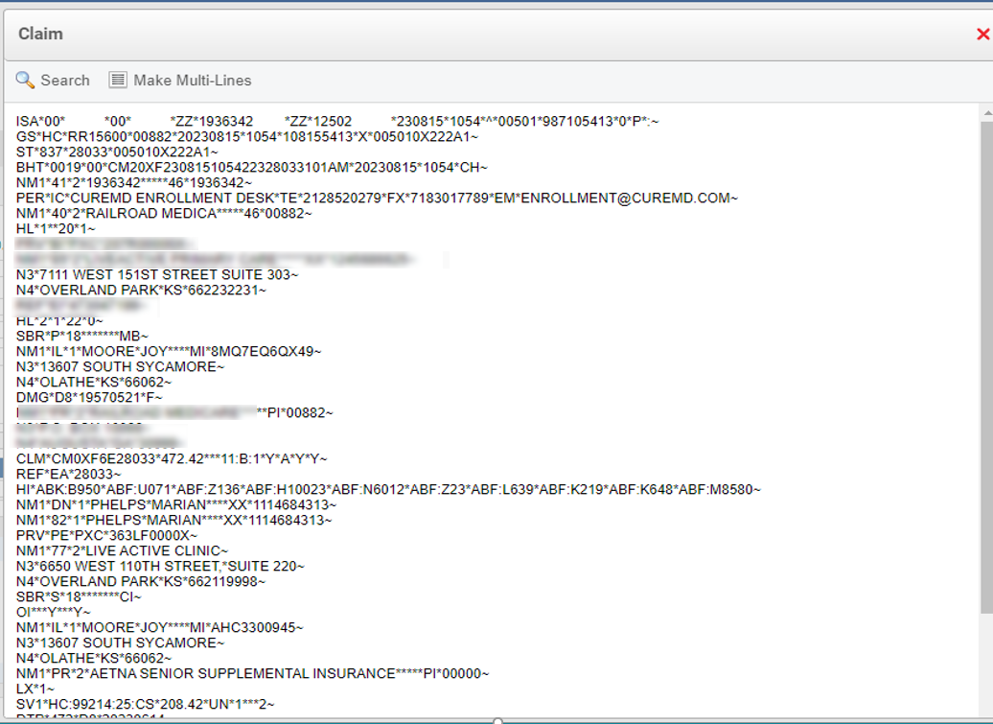
Standard format of EDI File

Slide 8
Project analysis slide 8
Claim forms The two most common claim forms are the CMS-1500 and theUB-04.
The UB-04 (CMS 1450) is a claim form used by hospitals, nursing facilities, in-patient, and other facility providers. A specific facility provider of service may also utilize this type of form.
The HCFA-1500 (CMS 1500) is a medical claim form used by individual doctors & practices, nurses, and professionals, including therapists, chiropractors, and out-patient clinics. It is not typically hospital-oriented.
Paper
Electronic
Professional Services
Each paper claim form has an equivalent electronic counterpart
837P
HCFA1500
CMS1500
Institutional and
Organizational
UB-04
837I

Slide 9
Project analysis slide 8
What are EDI rejections?
EDI rejections refer to instances where electronic transactions submitted through Electronic Data Interchange (EDI) systems are not accepted by the receiving party (insurance) or entity.
These rejections occur due to various reasons, such as errors, discrepancies, missing information, or non-compliance with the specified standards and requirements for the electronic transaction.
In the context of medical billing, EDI rejections can occur during the submission of claims, eligibility verification, and other billing-related processes.

Slide 10






Project analysis slide 2
REASONS of REJECTION
In medical billing, a claim rejection refers to a situation where an insurance company refuses to process a submitted healthcare claim due to errors or issues in the claim submission.
Incorrect Patient Information
Coding Errors
Missing Documentation
REASONS
Expired Coverage
Duplicate Claims
Out-of-Network Services
Coordination of Benefits (COB) Issues
Timely Filing Limits
Billing Errors
Invalid Authorization

Slide 11
Project analysis slide 8
Common reasons for claim rejections in Medical Billing:
Incorrect Patient Information: Errors in patient details such as name, date of birth, policy number, or insurance ID can lead to claim rejections.
Coding Errors: Incorrect medical codes (CPT, HCPCS, or ICD-10 codes) used to describe procedures or diagnoses can result in claim rejections. Proper coding is crucial to ensure accurate claim processing.
Missing Documentation: Insufficient or missing supporting documentation required for certain procedures can lead to claim rejections
Expired Coverage: If the patient's insurance coverage has expired or is no longer valid at the time of service, the claim might be rejected.
Duplicate Claims: Submitting the same claim multiple times for the same service can lead to rejections.
Out-of-Network Services: If the healthcare provider is not within the patient's insurance network, the claim might be rejected.
Timely Filing Limits: Insurance companies have specific timeframes within which claims must be submitted. Failing to submit a claim within the required timeframe can lead to rejection.
Invalid Authorization: Some procedures require prior authorization from the insurance company. Without proper authorization, the claim may be rejected.

Slide 12
Project analysis slide 8
Common reasons for claim rejections in Medical Billing:
Coordination of Benefits (COB) Issues: When a patient has multiple insurance policies, incorrect information regarding primary and secondary coverage can lead to claim rejections.
Billing Errors: Mistakes in the billing process, such as incorrect charges or units billed, can result in claim rejections
Payer ID: Missing or invalid payer ID leads to claim rejection.
Invalid NPI: Billing provider NPI missing or invalid.

Slide 13
Project analysis slide 4
Eligibility verification
it is a crucial step in the medical billing process that helps prevent claim rejections and denials by confirming a patient's insurance coverage, benefits, and other relevant information before providing medical services.
Patient demographic information
Online Portals and Automated Systems
Coverage and Benefits
Communication with patient
Patient’s Insurance Information
Interactive Voice Response (IVR) Systems
Supporting Documents
Referrals
Contact the Insurance Company
Payable benefits, co-pays, co-insurances, deductibles
Verification Details
Pre-Authorization

Slide 14
Project analysis slide 5
Detailed breakdown of the eligibility verification process:
1. Patient Information Collection:
Gather accurate and complete patient demographic information, including name, date of birth, address, phone number, social security
number, and any other required identifiers.
Obtain the patient's insurance information, including the insurance company's name, policy number, group number, and subscriber
information if applicable.
2. Contact the Insurance Company:
Utilize various methods to verify eligibility and benefits, such as calling the insurance company's provider services or using online
portals.
Verify the availability of an automated eligibility verification system provided by the insurance company, which allows real-time
access to patient coverage information.
3. Online Portals and Automated Systems:
Access the insurance company's online provider portal or automated eligibility verification system.
Log in using secure credentials and input the patient's information to retrieve eligibility details.
Some systems provide instant verification, displaying coverage and benefits information in real-time.
4. Interactive Voice Response (IVR) Systems:
Use phone-based IVR systems to verify eligibility by calling the insurance company's provider services number.
Follow the prompts and input the patient's information using touch-tone responses or voice recognition.

Slide 15
Project analysis slide 8
Here's how EDI is typically used in medical billing
Claim Submission: Healthcare providers can electronically submit insurance claims to insurance companies for reimbursement. This includes details about the services provided, diagnosis codes, procedure codes, patient information, and more. EDI makes this submission process faster and more accurate compared to manual paper submissions.
Remittance Advice: Insurance companies send electronic remittance advice (ERA) to healthcare providers, detailing the payments made for each claim. This includes information about approved or denied services, reasons for denial, and payment amounts. This helps providers reconcile their accounts and track payments more efficiently.
Eligibility and Benefits Verification: EDI allows healthcare providers to electronically check patient eligibility and benefits before providing services. This helps providers understand coverage limits, co-payments, deductibles, and other relevant information, ensuring smoother financial interactions with patients.
Status Inquiries: Providers can electronically inquire about the status of claims to get updates on whether a claim has been received, processed, or paid by the insurance company.
Coordination of Benefits: When a patient has multiple insurance plans, EDI helps coordinate benefits between different insurance providers to determine which one is primary and which is secondary for the claim.
Authorization Requests: For certain medical procedures or services that require pre-authorization, providers can electronically submit authorization requests to insurance companies through EDI.

Slide 16
Project analysis slide 5
Types of Eligibility statuses
Plan offering real time eligibility
P – Pending.
E - Eligible/Active.
NE - Not Eligible/Inactive.
Er - Error due to any reason.
U - Unavailable due to any reason.
Plan not offering real time eligibility
Manual-P [Manually eligibility never inquired/verified/validated]
Manual-E [Patient is marked as eligible/Active after verifying eligibility from call/web portal/availity
Manual-NE [Patient is marked as not eligible/Inactive after verifying eligibility from call/web portal/availity

Slide 17
Project analysis slide 5
How to verify if an insurance offer Real Time eligibility
In case of Realtime
By making an Inquiry from Cure Client Access Management (Curecam)
By searching on CureConnect portal in “Payer List”
By searching on Availity portal (EDI Clearinghouse)
By searching on Insurance web portal 5. By making call: a. To insurance b. To patient 6. If all the methods are completed and still the eligibility remains non-verified then it goes into “problem list” where contact is made with the client/doctor
In case of Non Realtime
Call Insurance
Through Availity web portal
Through Insurance web portal
Call patient
Notify to client through “Problem list”

Slide 18
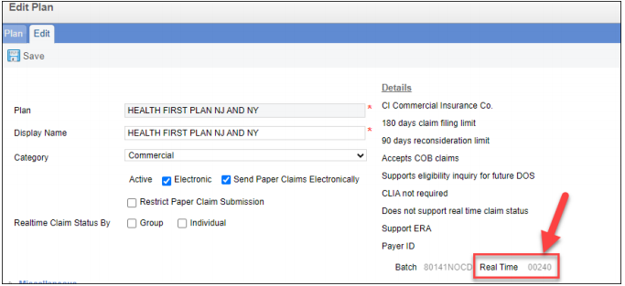
Project analysis slide 5
How to check if an insurance offer Real Time eligibility
There are two ways to check whether a plan/insurance offers real time eligibility or not.
Verify from CureMD application using Edit Plan option
Login to Curecam using below link.
https://curecam.curemd.com/curecamsecure/Login.aspx
Open Client from Curecam
Open a patient by account number, name, member ID etc.
Go to insurance page and click on the insurance name
Then click on the Pencil/Edit Icon left to Active checkbox
If Real-time payer ID is available then plan offers real-time eligibility [See below screenshot]
If Real-time payer ID is blank or not available then plan does not offer real-time eligibility

Slide 19
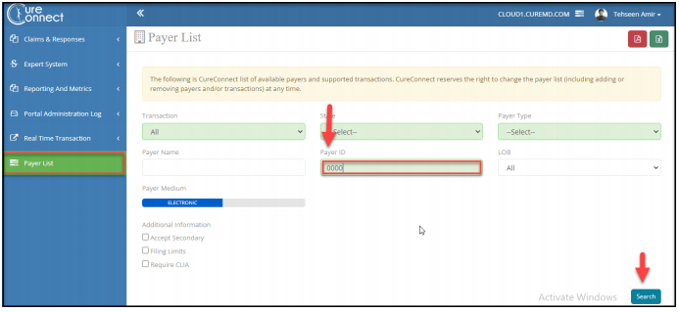
Project analysis slide 5
How to check if an insurance offer Real Time eligibility
There are two ways to check whether a plan/insurance offers real time eligibility or not.
Check from CureConnect/CC Portal
Login to CureConnect portal using below link)
https://ccportal.curemd.com/LoginForm.aspx
Open “Payer List”
Enter “Payer ID” and search. (Payer ID / “Batch ID” is taken from “Edit Insurance plan” option in Curecam) [see below Screenshot]

Slide 20
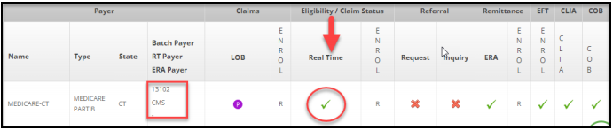
Project analysis slide 5
How to check if an insurance offer Real Time eligibility
There are two ways to check whether a plan/insurance offers real time eligibility or not.
If insurance offers RTE then there will be a “tick mark” under Realtime Eligibility / Claim status.
If it is not the case then “cross mark” will appear in the said position. [See below screenshot]

Slide 21
Project analysis slide 4
How to interpret and read Realtime Eligibility from CureMD application
When the Realtime Eligibility is inquired on Curecam, there comes the detailed list of services being offered, benefits being covered and particular type of insurance. This gives the clear picture regarding following aspects of an insurance
Benefit of Coverage
Procedures Covered
Service Type:
Effective/
Eligibility date
Insurance Type
Amount Covered
Coverage level
Additional Plan

Slide 22
Project analysis slide 5
Services offered under an insurance plan
Mainly we are concerned with:
Health Benefit Plan Coverage
Medical Care
Diagnostic Medical
Hospital Emergency Medical,
Professional (Physician) Visit – Office
Dental (except routine/preventive dental coverage)

Slide 23
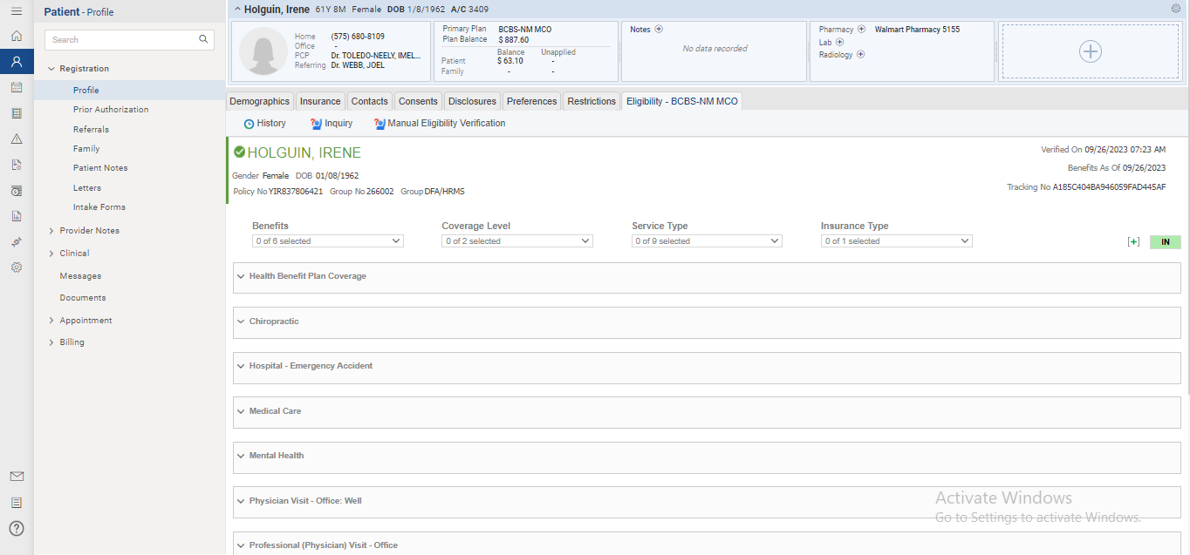
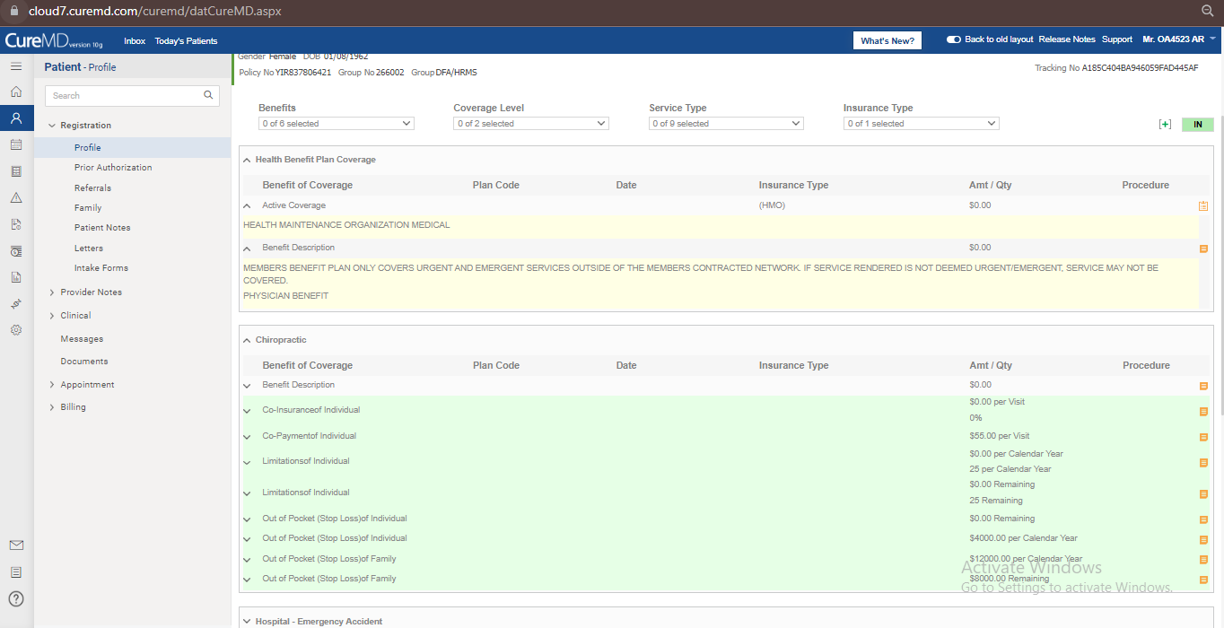
Project analysis slide 5
Services offered under an insurance plan

Slide 24
Project analysis slide 5
Benefit of Coverage
Those health care services to which a covered person is entitled under the terms of a health benefit plan. It includes:
Active coverage: Tells about which insurance provides cover.
Co-Insurance: Coinsurance is the percentage of cost paid after paying deductible. It is generally covered by the secondary insurance plans (only if their fee schedule and conditions allow). If not by secondary insurance, it is then paid by the patient.
Co-Payment: Copays are a fixed fee/percentage you pay when you receive covered care e.g. an office visit or drugs prescription. It is an upfront payment and is made for every new visit. It is included in the fee schedule and is mentioned separately
Deductibles: A deductible is the amount of money you must pay before your health insurance company starts paying. It is an annual expense and unless it is done, insurance will not pay. If your plan’s deductible is $1,500, you’ll pay 100 percent of eligible health care expenses until the bills total $1,500. After that, you share the cost with your plan by paying coinsurance.

Slide 25
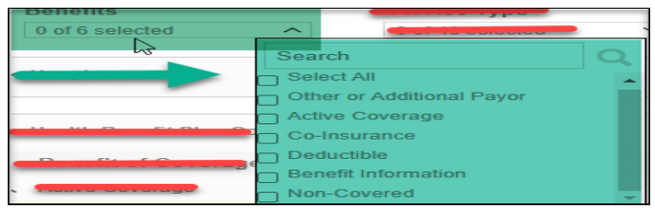
Project analysis slide 5
Benefit of Coverage
Out of Pocket: Out-of-pocket expenses are the medical expenses you must pay yourself. It includes
deductibles, co-payments and co-insurances.
Out of Pocket maximum/limit: The most you have to pay for covered services in a plan year. After
you spend this amount on deductibles, copayments, and coinsurance for in-network care and services,
your health plan pays 100% of the costs of covered benefits.

Slide 26
Project analysis slide 5
How to prevent EDI rejections?
Ensure Accurate Data Entry: Double-check all data entered into the EDI system, including patient information, procedure codes, diagnosis codes, and provider details. Even a small type of mistake can lead to a rejection.
Stay Current with Code Sets and Standards: Stay up-to-date with the latest coding standards, such as ICD-10, CPT, HCPCS codes and modifiers. Use valid and current codes to avoid rejections.
Verify Patient Eligibility: Before providing services, verify the patient's insurance coverage, benefits, and eligibility. This helps prevent rejections due to coverage issues.
Use Clear and Complete Documentation: Attach any required supporting documentation, such as medical records or authorization forms, to the EDI transaction to provide context and justification for the billed services.
Regularly Update Provider Information: Keep provider information, including National Provider Identifier (NPI) and tax identification numbers, updated and accurate in both your internal system and the EDI system.
Implement Data Validation: Use automated data validation tools within your EDI system to catch common errors and discrepancies before submitting transactions.
Utilize Pre-Submission Edits: Many EDI systems offer pre-submission edit capabilities that can flag potential issues before submitting transactions. Use these features to catch errors early.
Train Staff Effectively: Ensure that your billing staff is trained on proper EDI procedures, coding standards, and the use of the EDI system. Continuous education can reduce errors.

Slide 27
Project analysis slide 5
How to prevent EDI rejections?
Regularly Monitor and Audit: Establish a system of regular monitoring and auditing to identify trends in rejections and address recurring issues.
Follow Timely Submission Practices: Adhere to submission deadlines to avoid rejections due to timing issues.
Communicate with Payers: Maintain open lines of communication with insurance companies to understand their specific requirements and address any concerns.
Address Rejections Promptly: When a rejection occurs, promptly review the rejection message to understand the reason. Correct the issue and resubmit the transaction as soon as possible.
Implement Clear Workflow Processes: Develop clear workflows for submitting and reviewing EDI transactions. Standardized processes can reduce errors.
Regularly Update Software: If you're using third-party software for EDI transactions, keep it up-to-date with the latest patches and updates to ensure compatibility with changing standards.
Test Transactions: If possible, perform test transactions to ensure that your EDI system is functioning correctly before submitting actual transactions.
Document Rejection Reasons: Keep a record of common rejection reasons and their resolutions. This can help you proactively prevent similar rejections in the future.
Minimizing EDI rejections requires a combination of attention to detail, ongoing training, process optimization, and effective use of technology. By implementing these strategies, healthcare providers can streamline their billing processes, reduce administrative overhead, and ensure smoother interactions with insurance companies.

Slide 28
Project analysis slide 5
Key Takeaways
Rejected claims aren’t denials A denied claim is one that’s fully processed by the insurance payer A rejected claim isn’t processed the payer’s system Payer’s don’t keep rejected claims in their system Rejection messages tell you what you need to adjust within the claim such as: Member ID card Diagnosis codes Coordination of benefits (COB) If the rejection message relates to the Billing Provider, Rendering Provider, or Tax ID, you’ll have to verify provider credentials with the payer Clearinghouse-level rejections happen instantly, provider-level rejections take at least two days Your clearinghouse also stores a repository of all of your rejections for you to work through individually or in bulk If you call a payer to discuss claim rejection, note the following: Representative name Number you called Call reference number Your clearinghouse should be able to act as the middleman between you and the payer so that you don’t have to worry about claim submission requirements

Slide 29
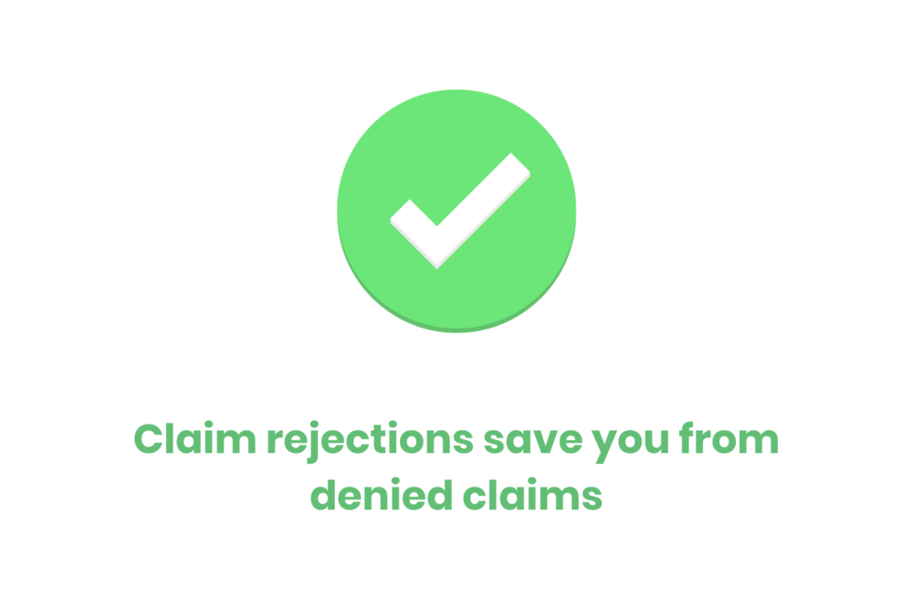

Slide 30
Thank You

